Slide 1
why’d ya spill yer beans?

Slide 2

Hello!
Model Behavior
Leon, Nicole, Victoria, Henry, Eleanor
Notes:
Henry/All

Slide 3
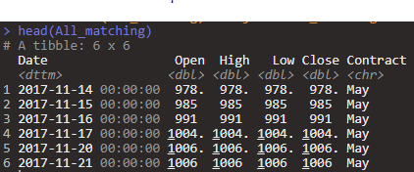
Understanding the Data
Soybean Contract Pricing
3 Sets of Data
Daily Information

Slide 4
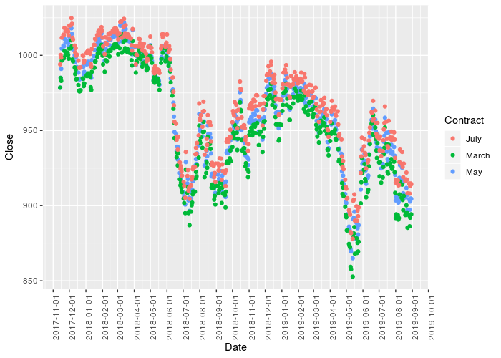
Global Trade Economy and Soybeans
U.S.-China Trade Disputes
Chinese Swine Fever Epidemic
Notes:
Henry

Slide 5
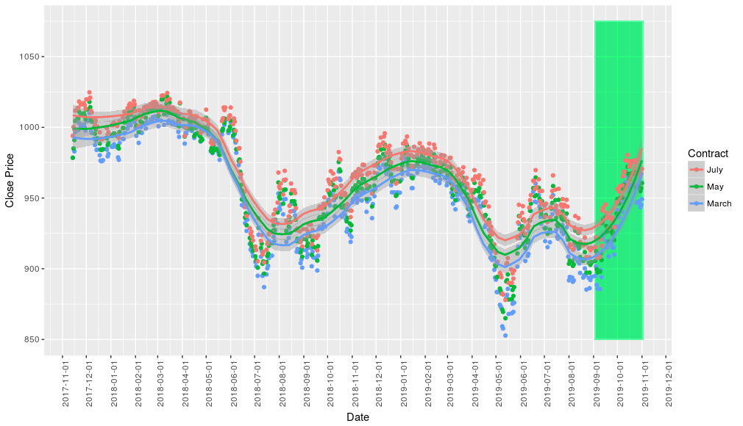
Price difference by contract date
External data from barchart.com
$1,176 difference
Notes:
Green box highlights outside data from september - Nov 1
All follow same pattern. Cut off July to show relationship better
July - May 7.6 cents per bushel
July - March 14.7 cents per bushel
May - March 7.1 cents per bushel
For 50 bushels an acre (average in MN) over a quarter section (160 acres) that’s $560 difference. Between March and July it’s $1,176.

Slide 6
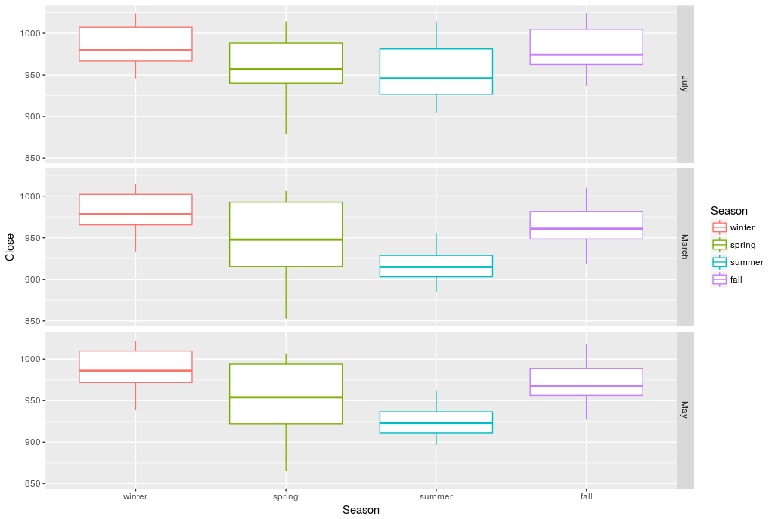
Seasonality: Seasons
$4,000 difference
Notes:
Eleanor
winter - 985
spring - 954
summer - 935
fall - 975
For 50 bushels an acre (average in MN) over a quarter section (160 acres) so 8000 bushels: 78800 in Winter vs 74800 Summer —> $4,000 difference
As you can see, there is a difference based on seasonality, which led us to use a time series analysis with seasonality, which Victoria will explain in further detail later

Slide 7
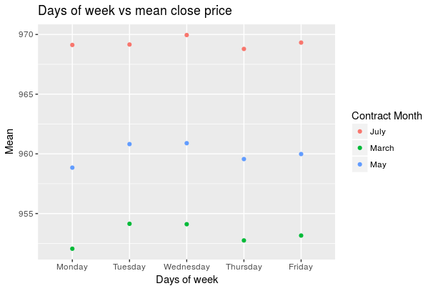
Seasonality: Days of the Week
$60-150 difference
Notes:
Eleanor
We also were curious to see if there was a difference in price based on the day of the week the contract was made. Here you can see a modest, yet visible difference in prices based on the day of the week, with Tues/Wed consistently being the highest price and the end of the week Thurs/Fri. While the difference between days is only a few cents, it can be a difference of over $150 for the average 50 bushels an acre (average in MN) over a quarter section (160 acres).
July: 969.3199 969.1221 968.7887 969.1591 969.9517 —> 66.368
May: 953.1576 952.0536 952.7473 954.1413 954.1075 —> 167.016
March: 959.9837 958.8452 959.5632 960.8179 960.8925 —> 72.704

Slide 8
Time Series Model
Predictors included
Seasonality
Yearly
Week
Exports, Planting Delays, Supply
Notes:
Victoria

Slide 9
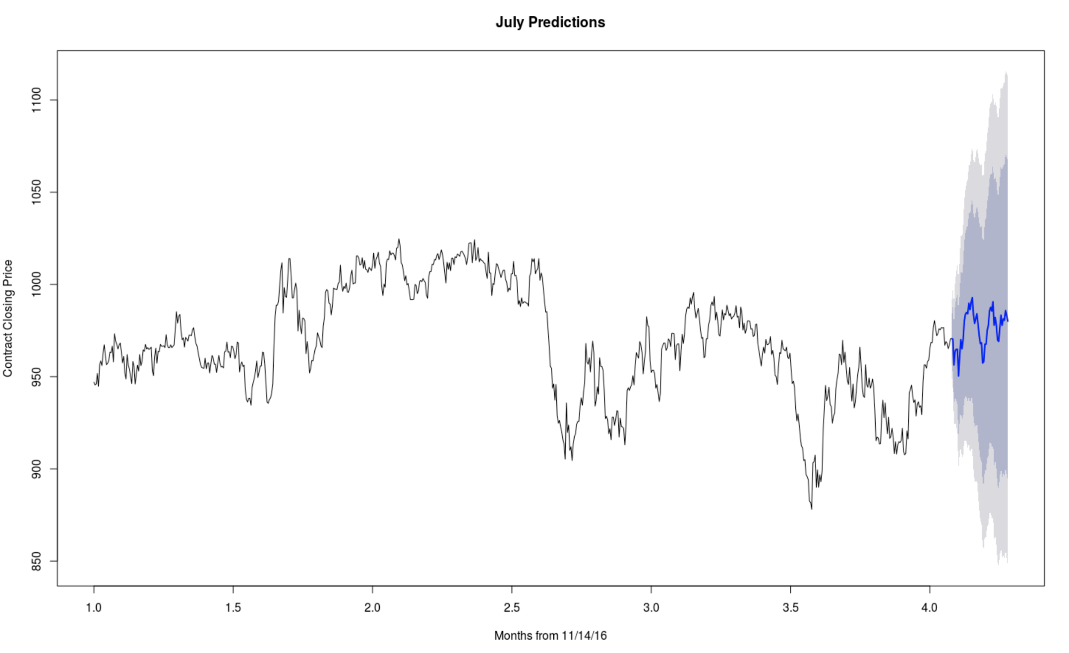
Predictors - Seasonality
SARIMA Model
Seasonal Autoregressive Integrated Moving Averages Model
Y_{t}=Y_{t-5} +Y_{t-243}+θ(Y_{t}+Y_{t-5} +Y_{t-243})+ϵ_{t}
Looked for autocorrelation in data after accounting for seasonality → added differencing
All contracts follow similar pattern, here July is shown
Notes:
Victoria

Slide 10
ARMA Regression Model with External Regressors:
Y_{t} = 1579.5 + ɑY_{t-5} + βY_{t-243} + θ( Y_{t}+ Y_{t-5} +Y_{t-243}) -76.18*Delay_{t} -45.37*Supply_{t} -34.98*Corn_{t} + ϵ_{t}
Where ϵ_{t} is defined in accordance to ARMA errors incorporating the two seasonal components (5, 243)

Slide 11
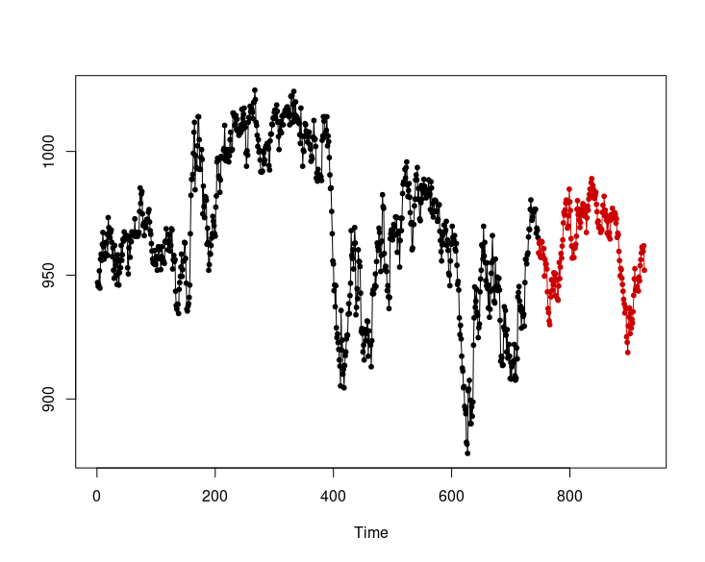
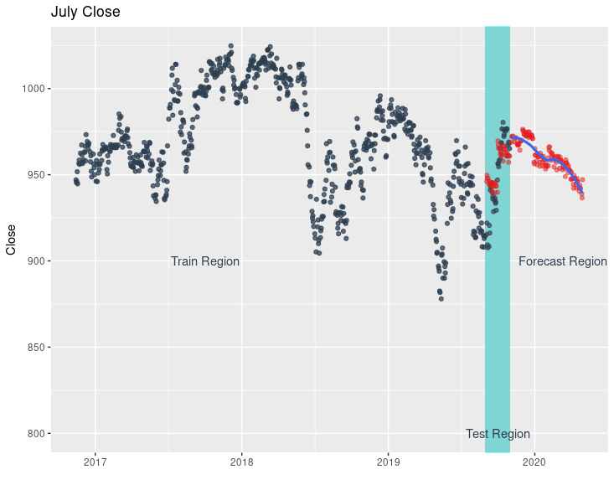
Other Models
KNN - K-Nearest Neighbor
GAM - Generalized Additive Model
July Close

Slide 12
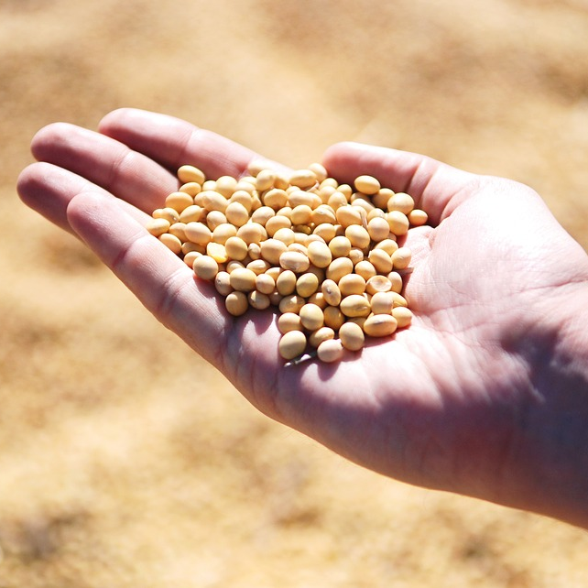
Conclusions

Slide 13
Limitations
Lack of specific US - Chinese trade data
Ideal data quantity for SARIMA model

Slide 14
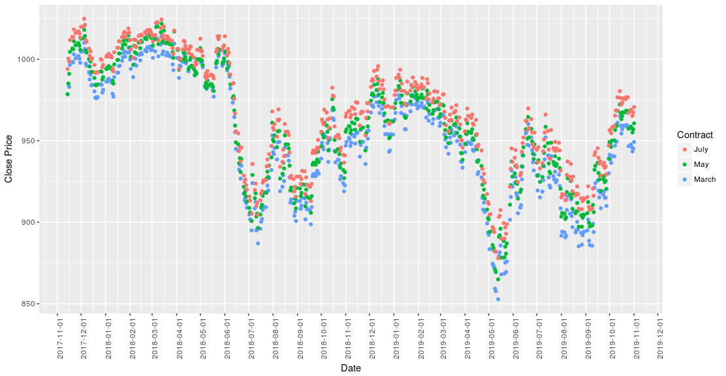
Advice to farmers
Doesn’t appear that prices will recover soon
Best time to make a contract
Some variables aren’t very predictable, so what can farmers do?
Notes:
Like Henry said looks like soy prices are going to remain low for a long time
Make contracts for July in the winter on a tuesday or wednesday
Can’t predict Trump’s policy or an outbreak of swine fever but we see that after them price drops and takes month to recover so keep up on these things in the news and either make a contract as soon as you hear about it or be prepared to wait a few months for it to recover
There is a period between when tariffs are announced before they are enacted so sell then

Slide 15
Thanks!
Thank you for your attention!
ANY QUESTIONS?

Slide 16
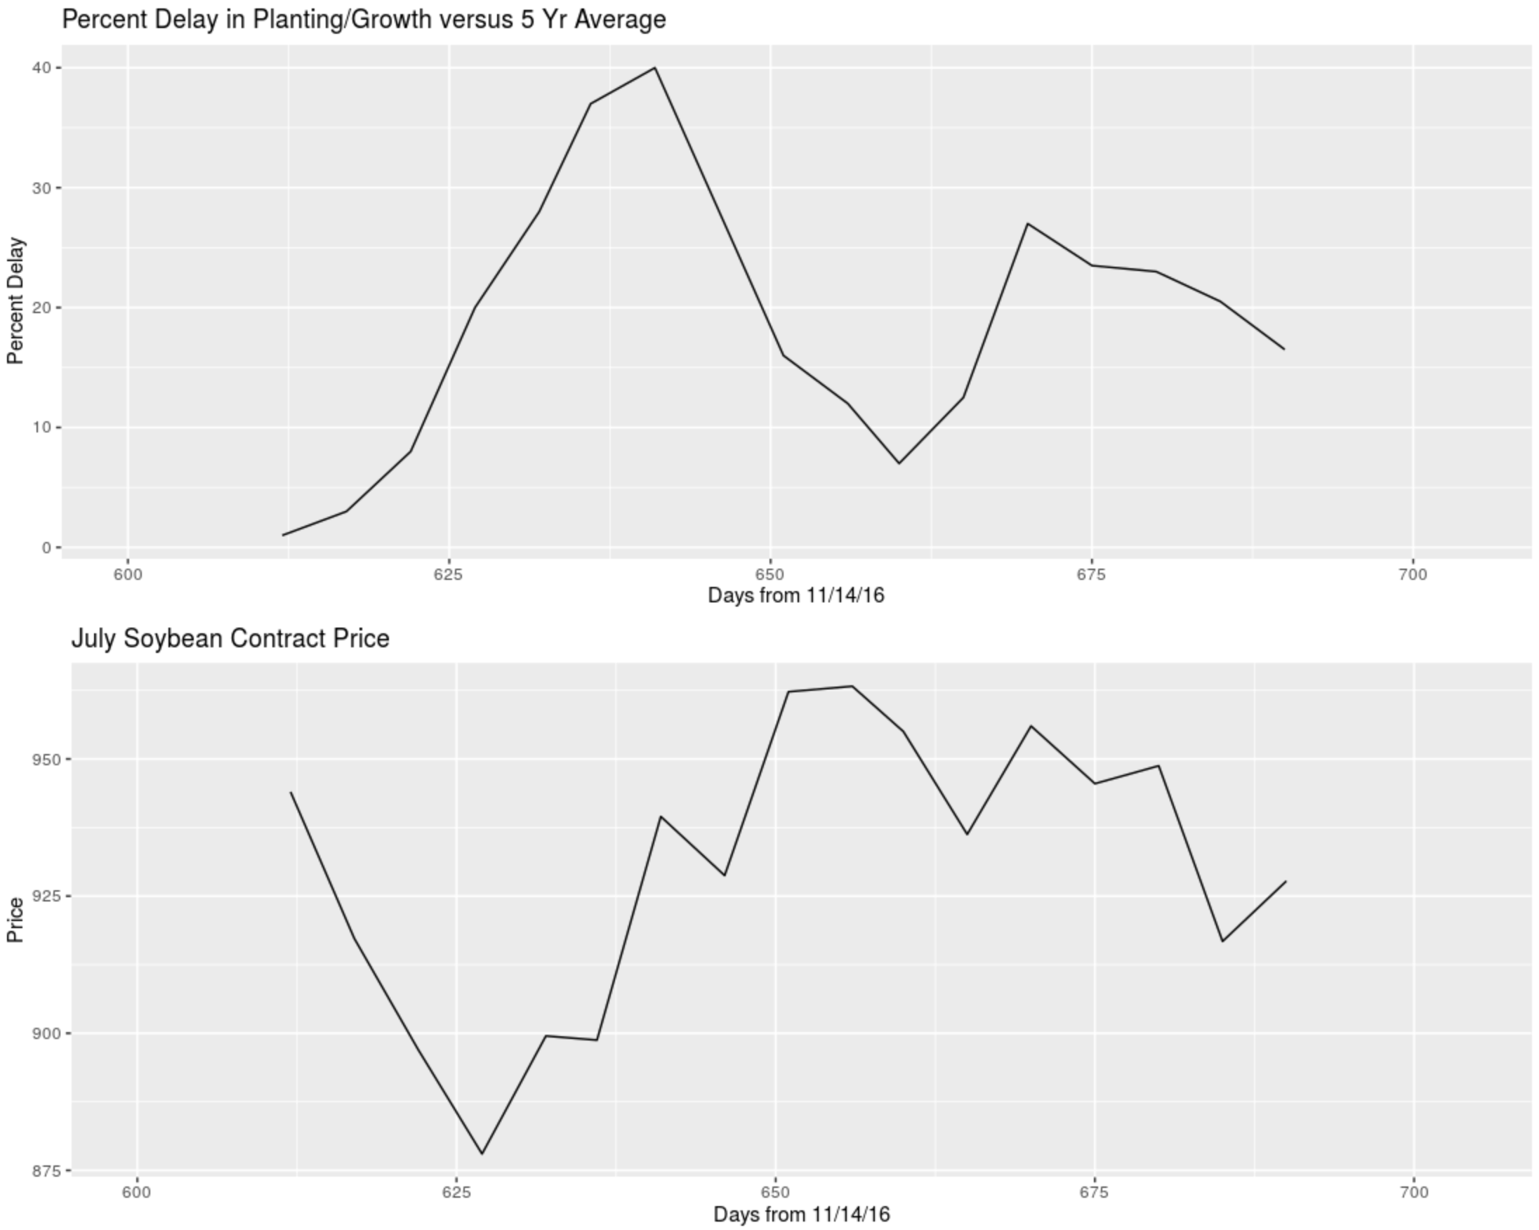
Predictors - Delayed Planting, Supply Total, Exchange Rates
A one unit increase in percent delay of planted, blooming, and setting pods compared to the 5 year average is associated with a 76 cent decrease in July contract price.

Slide 17
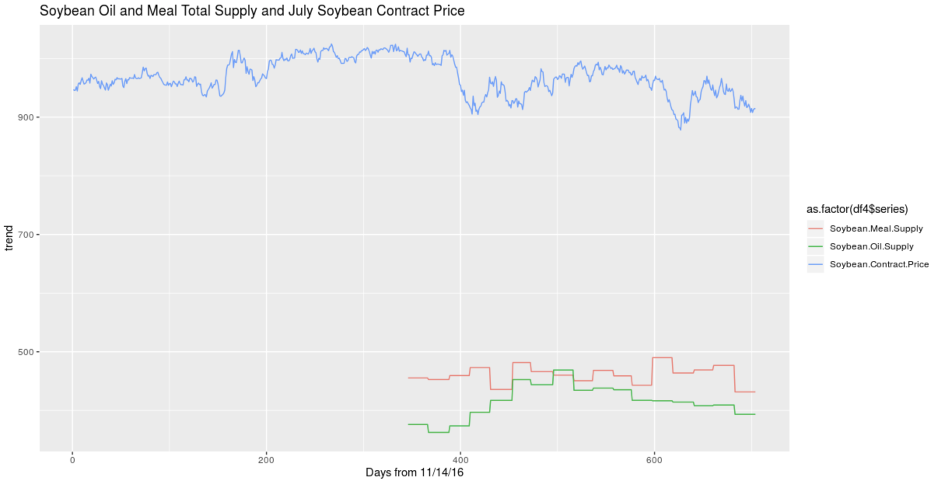
Predictors - Delayed Planting, Supply Total, Exchange Rates
A one unit increase in the total supply of Soybean Oil is associated with a 45 cent decrease in July contract price.

Slide 18
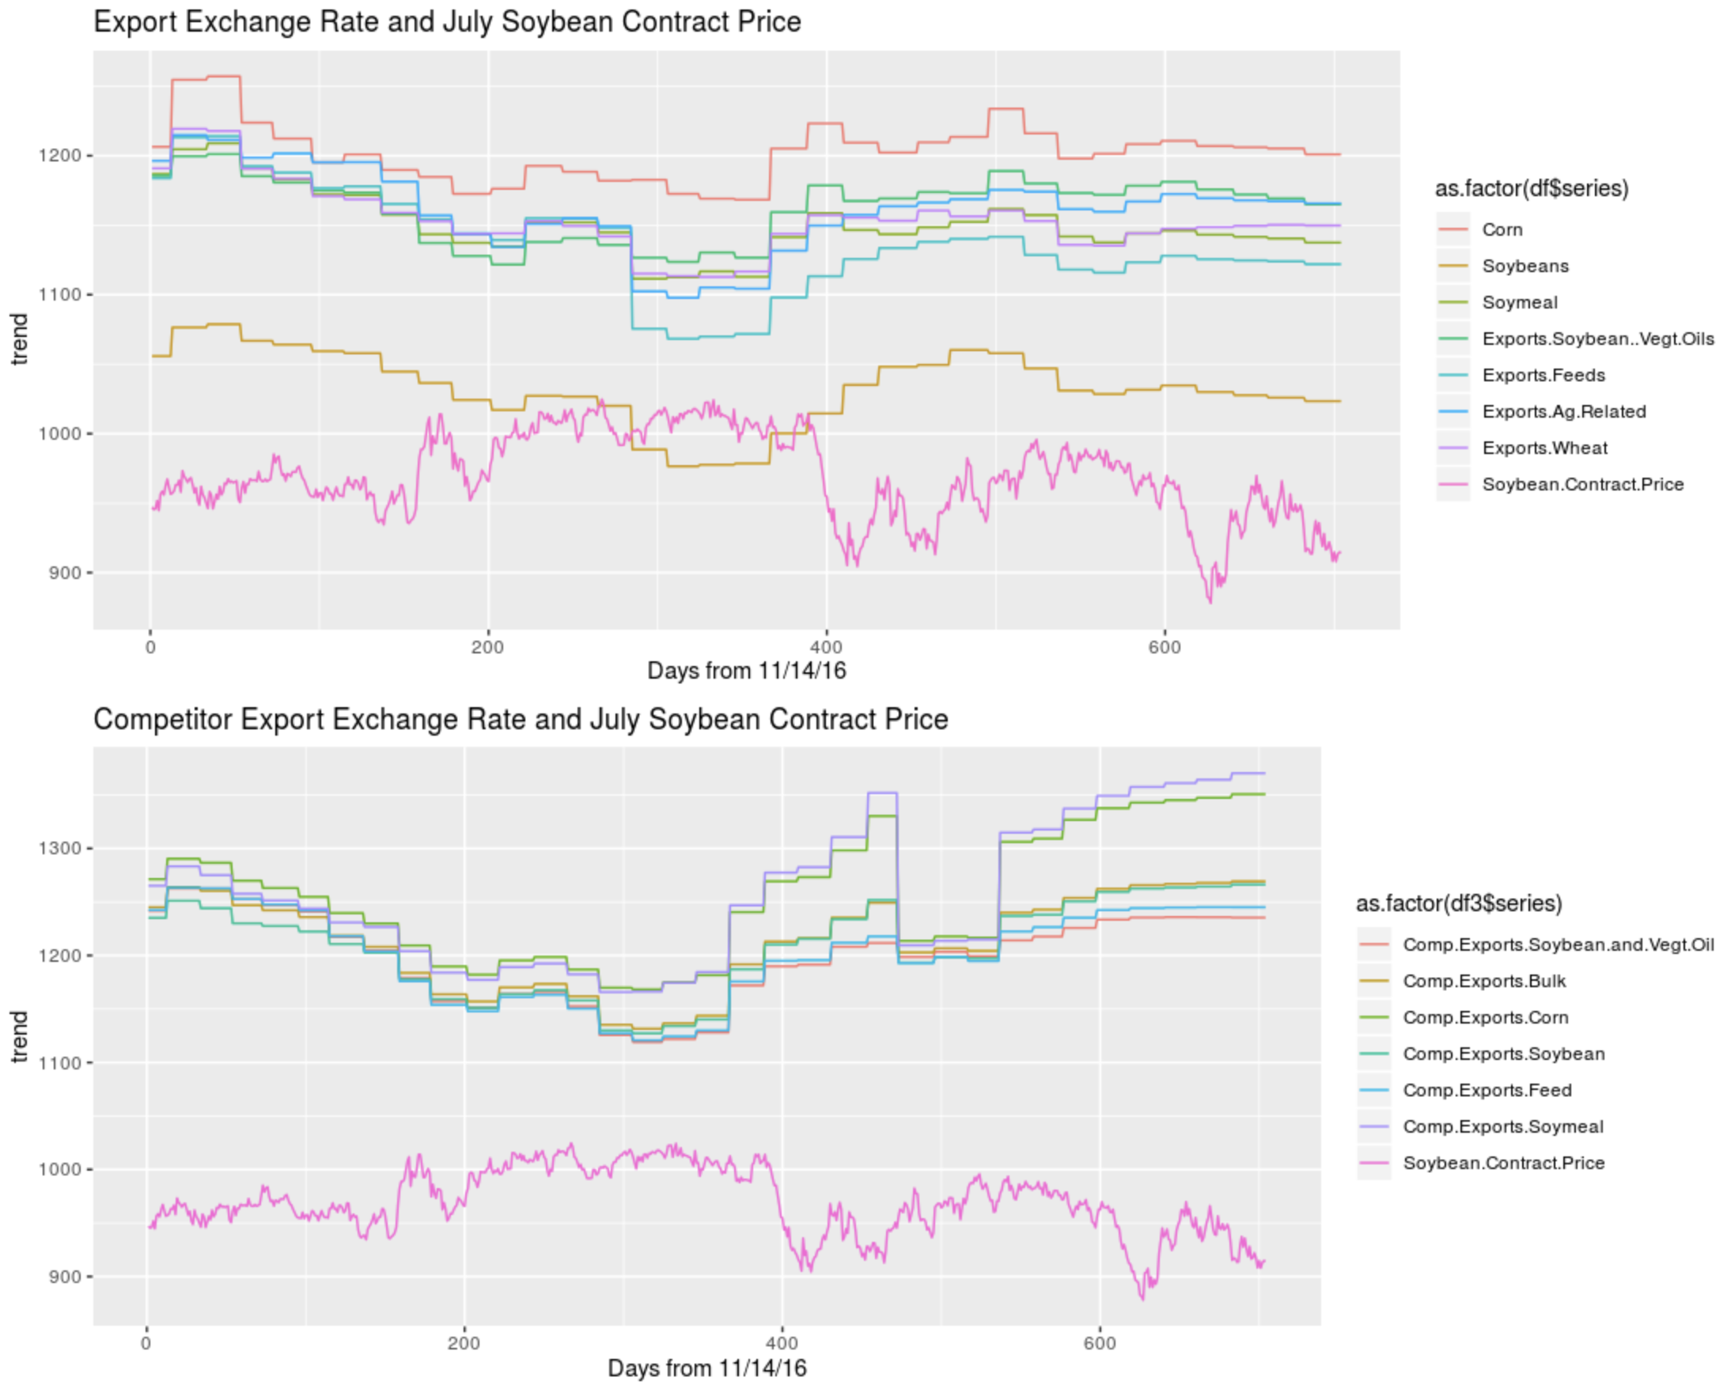
Predictors - Delayed Planting, Supply Total, Exchange Rates
A one unit increase in the competitor exchange rate of corn is associated with a 35 cent decrease in July contract price.

Slide 19
Other Models
KNN (K-Nearest Neighbors )
GAM (Generalized Additive Models )
Notes:
Leon
Report prediction errors

Slide 20
Model comparison
SARIMA:
Widely used
Work well for sequential data
Accounts for non-stationary data
KNN:
Simple implementation (no training)
Not capable of dealing missing values
GAM
Counts for curvature
Overfitting

Slide 21
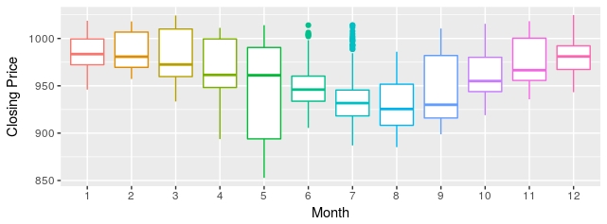
Seasonality’s role in predicting prices

Slide 22
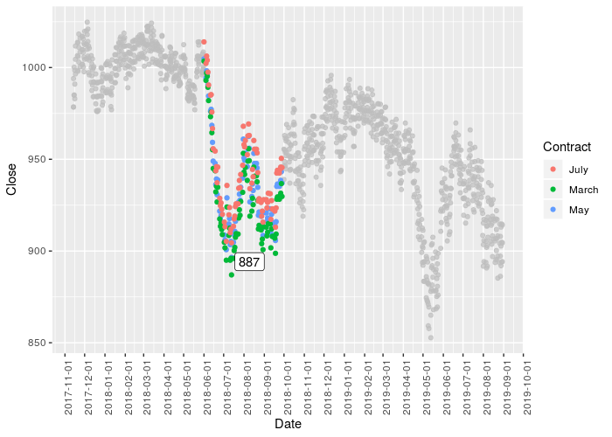
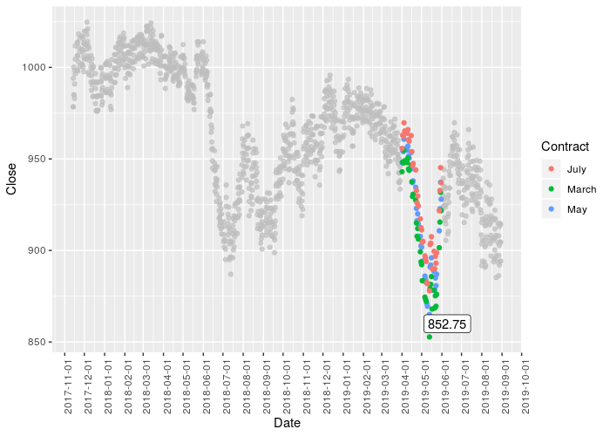
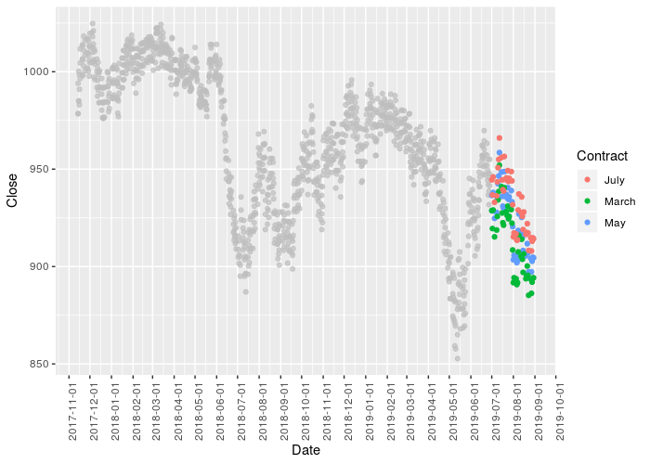
Notes:
Henry

Slide 23
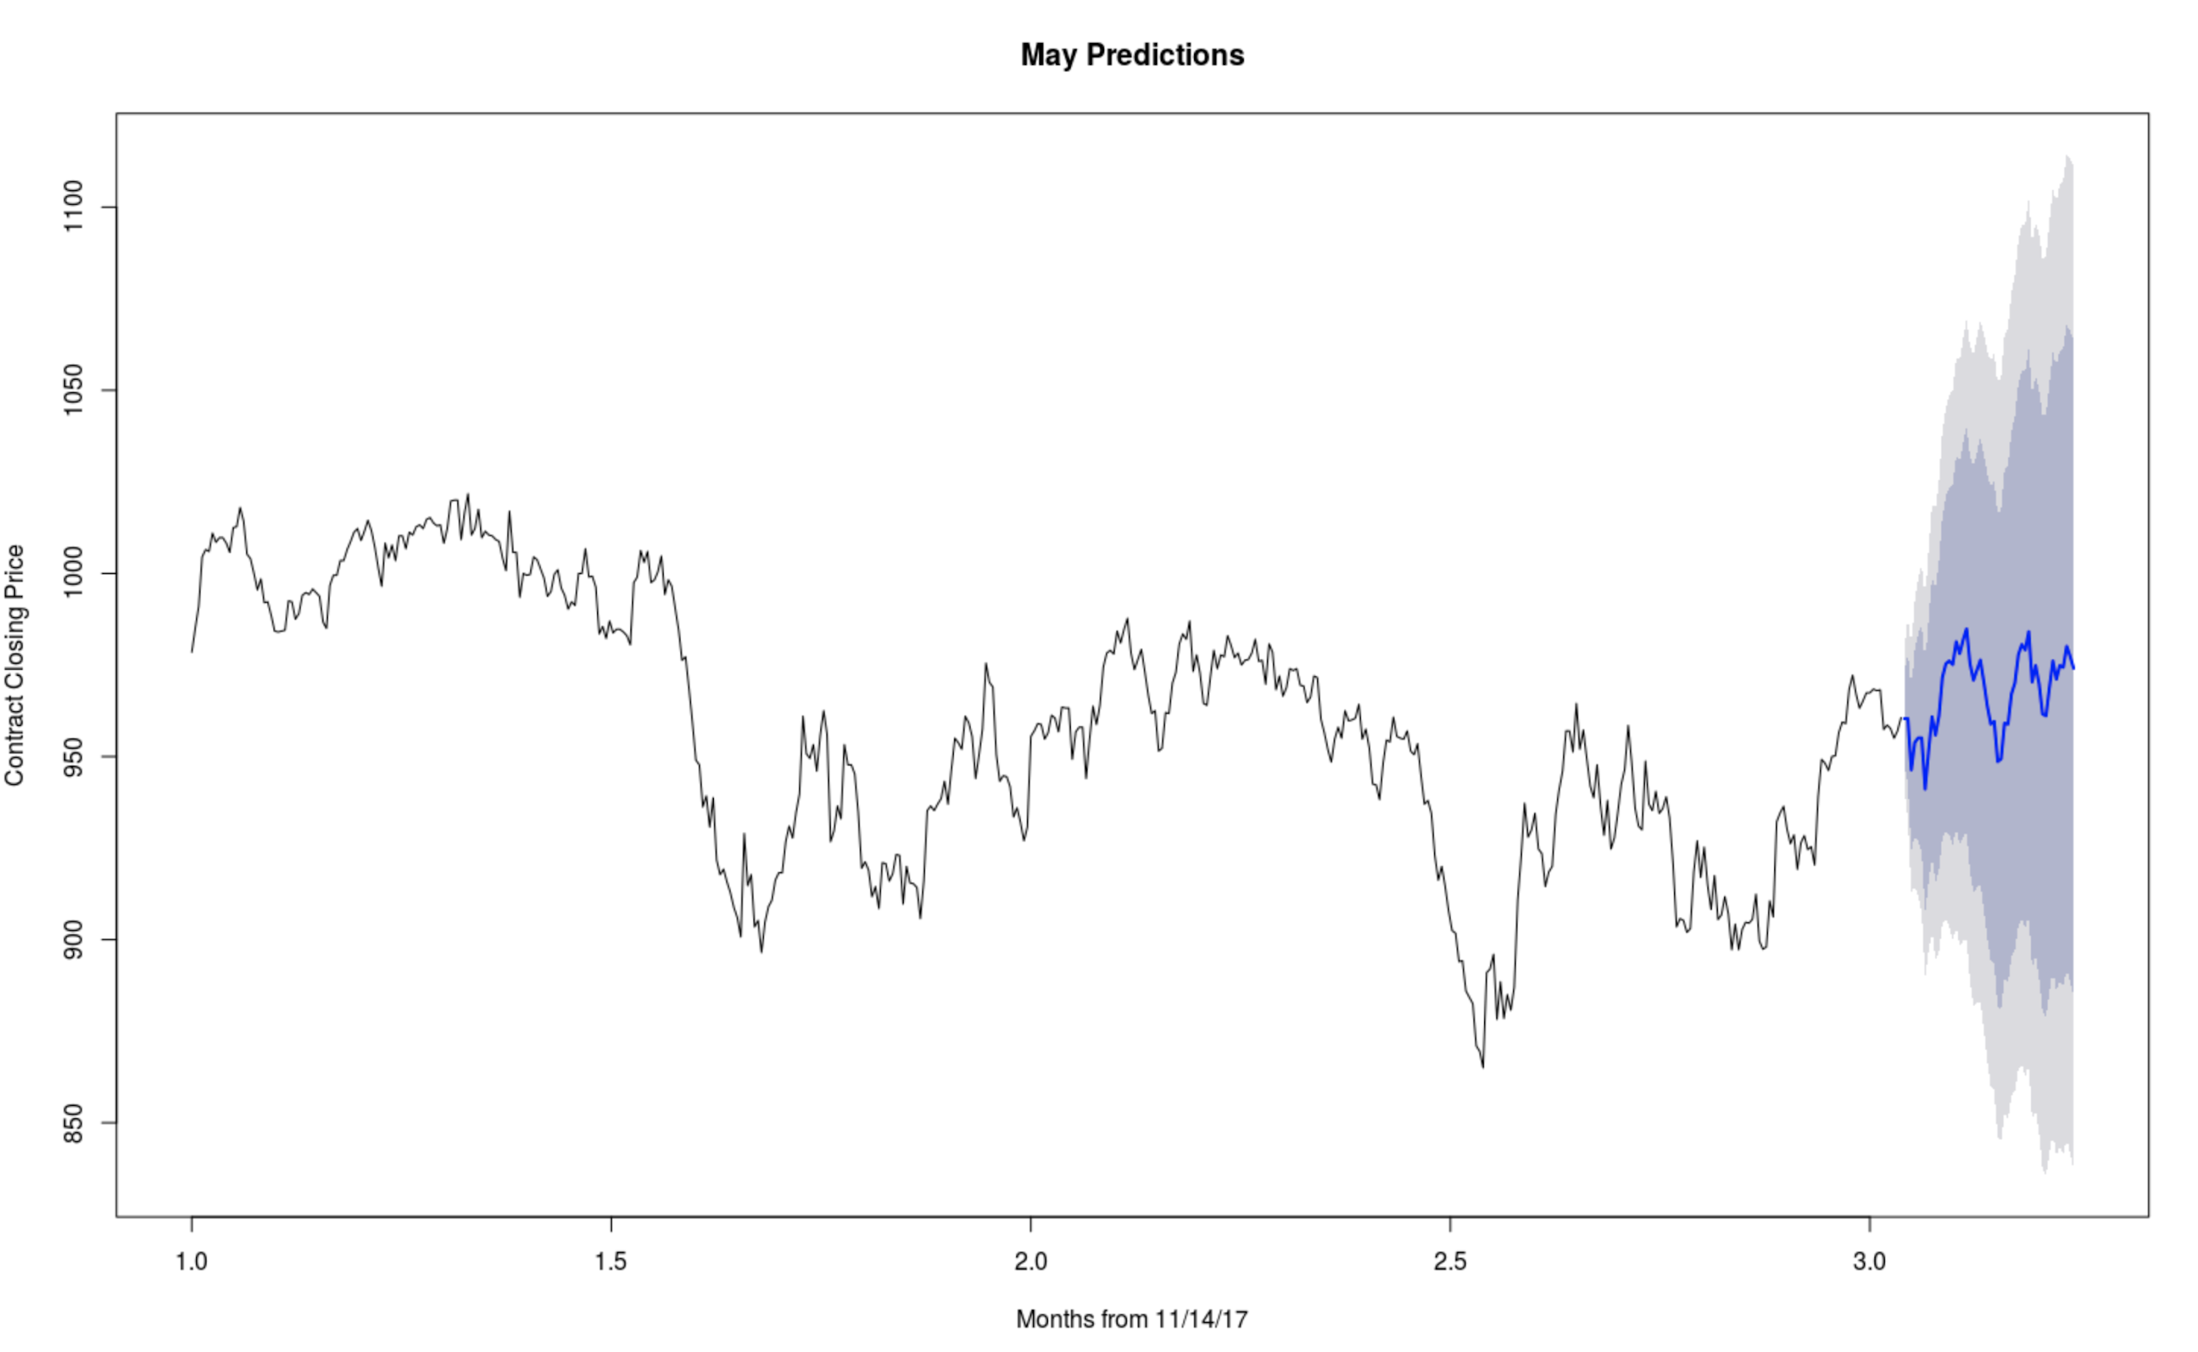
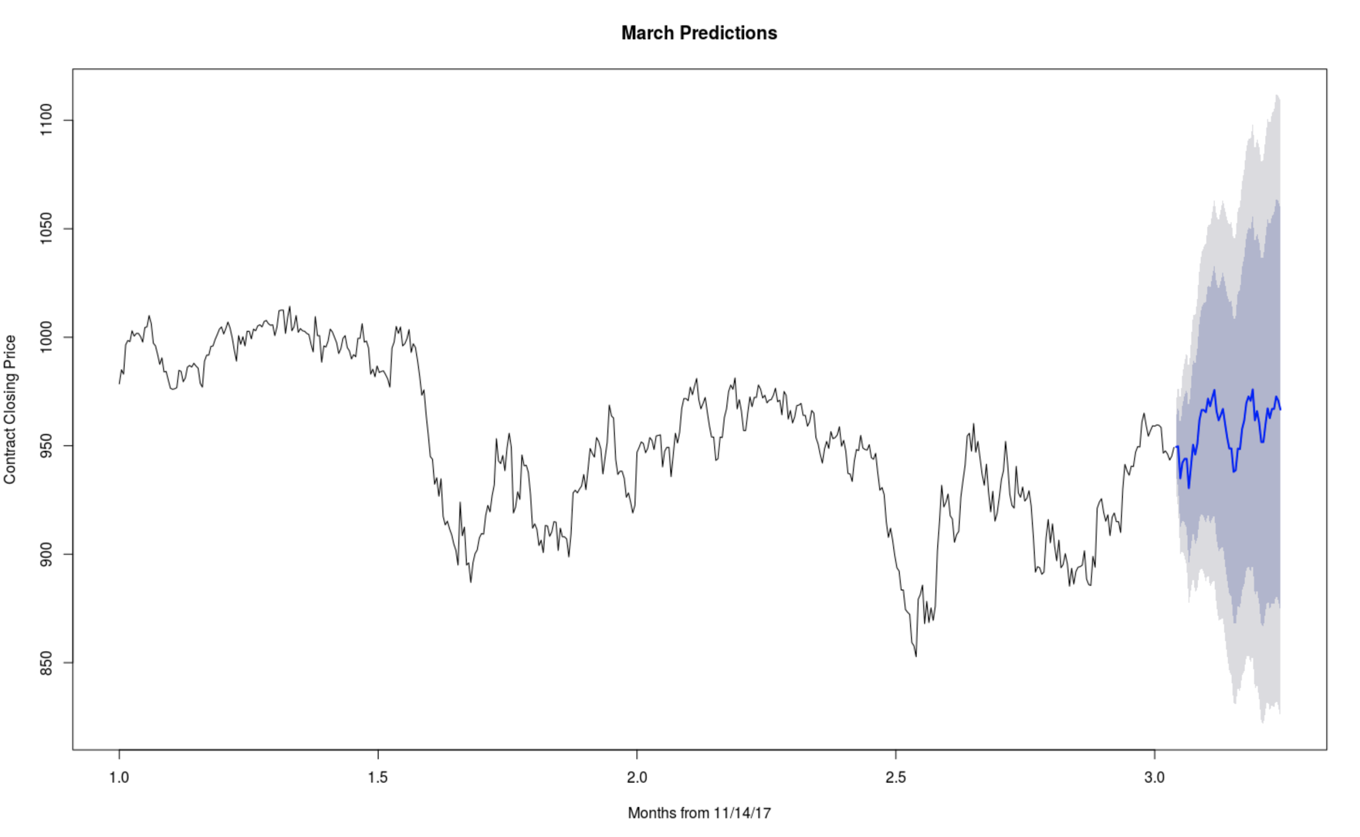
Other Month’s Predictions
Notes:
Henry

Slide 24
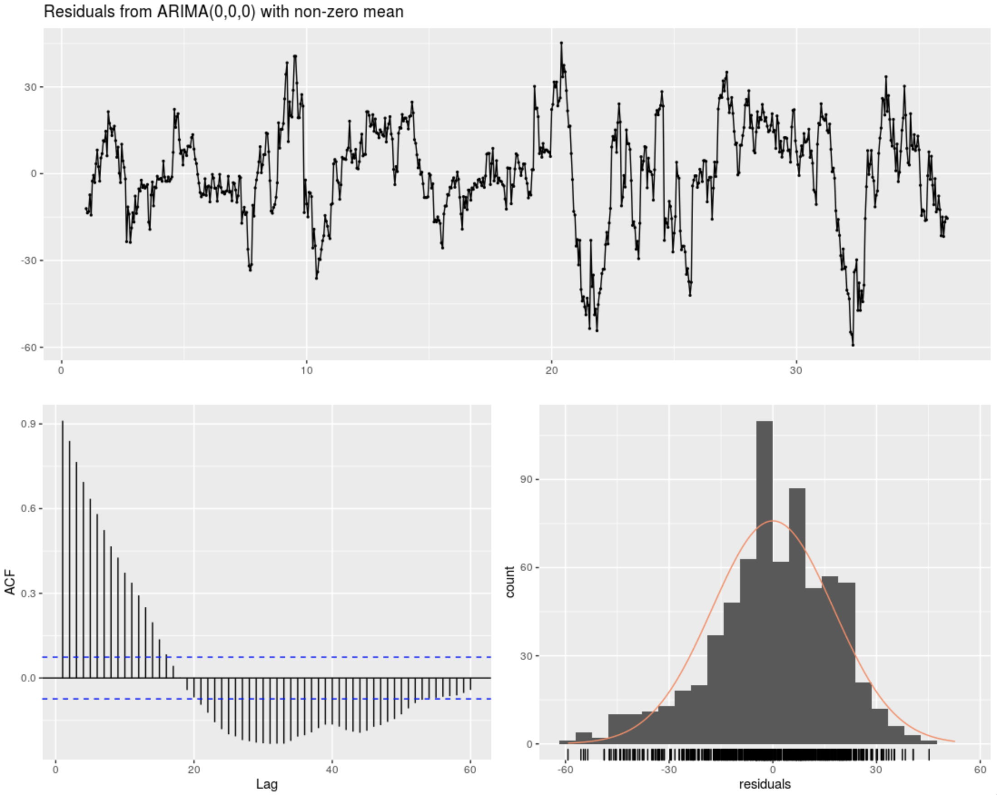
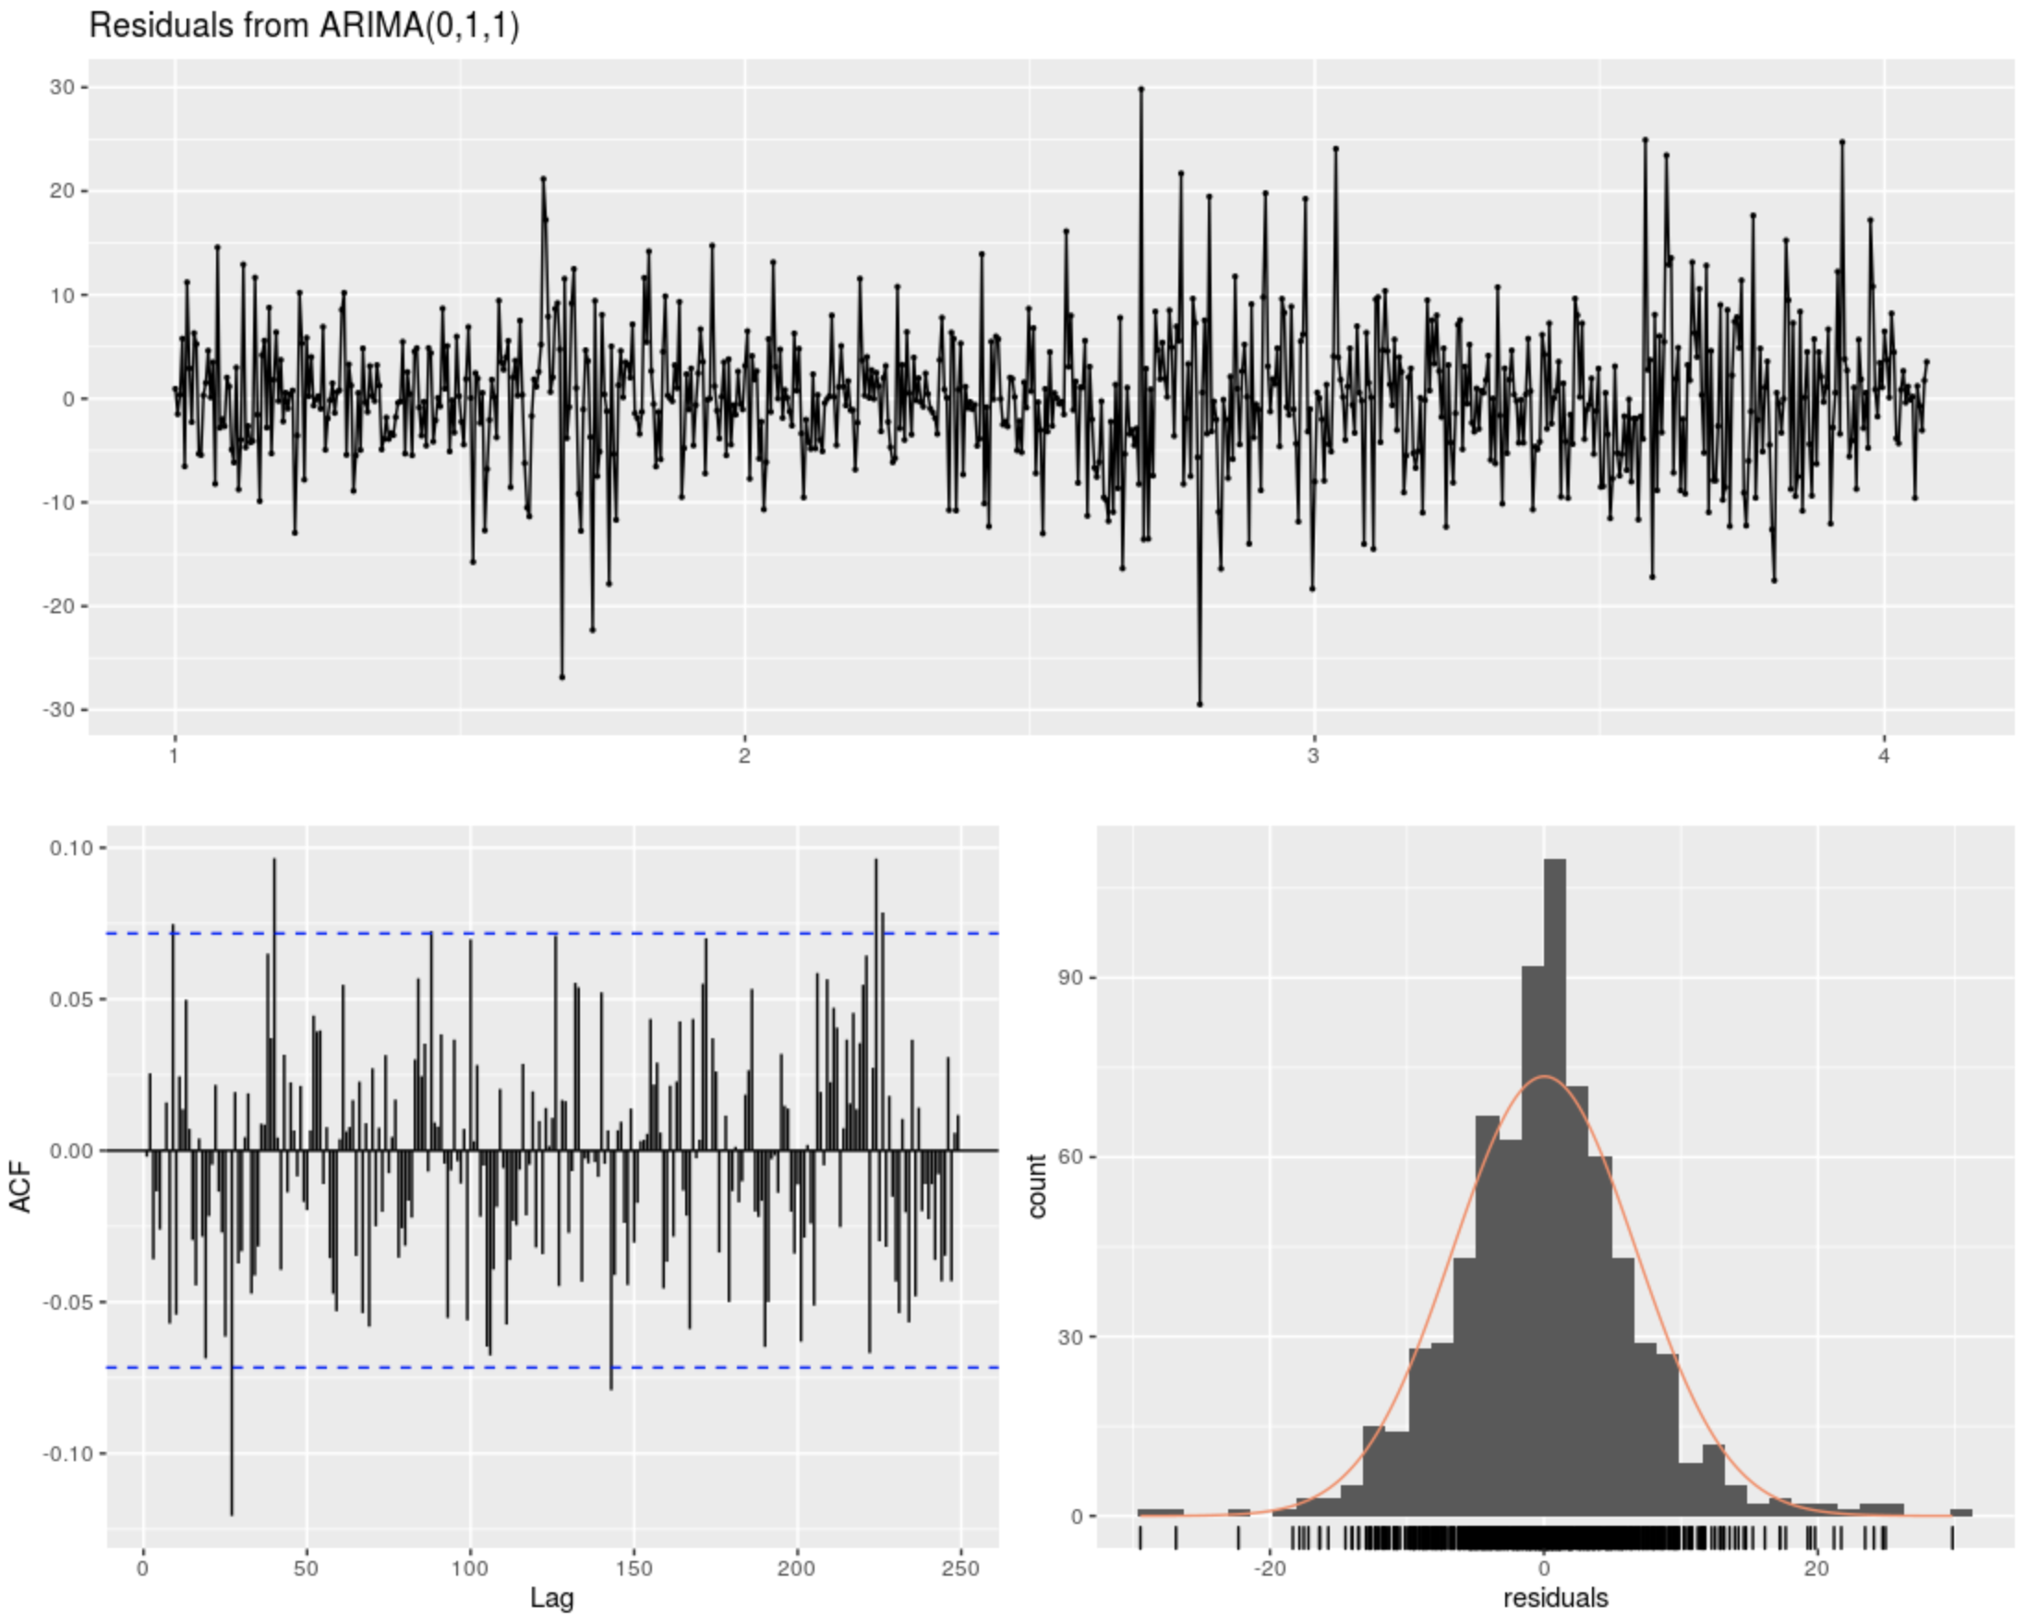
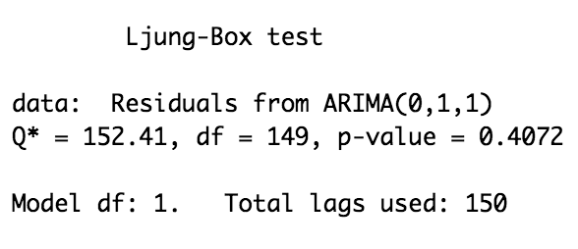
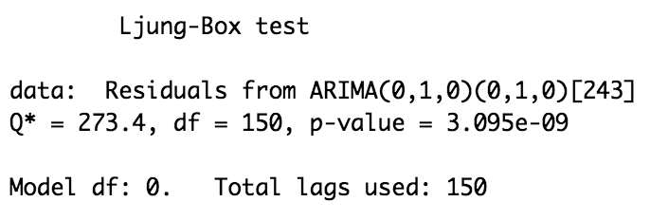
ARIMA Model Selection

Slide 25
Our Model
Predictors we were actually able to put in our final model
Notes:
Victoria

Slide 26
Background
What is our data?
Notes:
Victoria

